Slide 1
Coronavirus Disease 2019 (COVID-19): Management
Andreas J Deymann, MD
Chair of the Department of Pediatrics
Memorial Hospital South Bend
Justin Chow, MD, FACP, FHM
Hospitalist
Director of Mid-Level Program of Hospitalist Department
Memorial Hospital South Bend
Assistant Professor
Director of Internal Medicine Clerkship
Indiana University School of Medicine -South Bend

Slide 2

COVID 19
Caused by a novel beta coronavirus, Severe acute respiratory syndrome coronavirus 2 (SARS-CoV-2)
First case reported from Wuhan, China on 12/1/2019
Most infected individual exhibit a mild illness (80%+), 14 % serious and 5% critical illness.
10% require hospital admission due to COVID pneumonia, of which 10% will require ICU care.
Mortality rate 2.3% in China, 5.8% in Wuhan City and 0.7 in the rest of China. 0.9% in South Korea. 13% in Italy. About 5.5% in US.
Total cases: 2,585,195 ( US: 819,321)
Death: 179,839 ( US deaths: 45,356)

Slide 3
Local COVID 19 Data
Report to state from St Joseph County (Last update 4/17/2020)
  Total tests 1580
  Total positive 412 (positive rate 26%)
  Total death 9 (mortality rate 0.57%)
Beacon Medical Group (3/1-4/21/2020)
  Total tests: 643
  Total positive: 26 (positive rate 4%)
EGH (3/1-4/21/2020)
  Total tests: 482
  Total positive patients: 43 (positive rate 8.9%)
  Average time to result: 3.56 days
MHS/BGH (3/1-4/21/2020)
  Total tests: 429 (not counting repeat inpatient positives)
  Total positive patients: 52 (positive rate 12.12%)
  First inpatient 3/22/2020
  Death 6 (inpatient mortality rate 1.39%)
  Total intubated patients 8 (2 survived)

Slide 4
Risk Factors for COVID-19 Disease Progression
Epidemiological | Vital Signs | Labs
Age > 65 | Respiratory rate > 24 breaths/min | D-dimer > 1000 ng/mL
Pre-existing pulmonary disease | Heart rate > 125 beats/min | CPK > twice upper limit of normal
Chronic kidney disease | SpO2 ≤ 93% on ambient air
Diabetes with A1c > 7.6%
History of hypertension
History of cardiovascular disease
Obesity (BMI ≥ 30 kg/m2)
Use of biologics
History of transplant or other immunosuppression
Uncontrolled HIV (viremic or CD4 <200)
Massachusetts General Hospital

Slide 5
Lab Findings
Lymphopenia
Elevated liver enzymes
Elevated lactate dehydrogenase (LDH)
Elevated inflammatory markers (eg, C-reactive protein [CRP], ferritin)
Elevated D-dimer (>1 mcg/mL)
Elevated prothrombin time (PT)
Elevated troponin
Elevated CK
Acute kidney injury

Slide 6

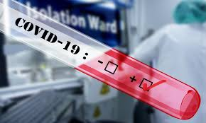
Labs For COVID 19
SARS COV 2 PCR
Blood cultures
CBC
BMP
LFT
CK
Troponin
Lactic acid
LDH
Procalcitonin
D-Dimer
Ferritin
PT/INR
PTT
IL 6
IgG level

Slide 7

Evaluation of COVID
Symptoms: DDx
Travel history: DDx
Sick contact: DDx
Physical exam: DDX.
Labs: DDx
Imaging tests: DDx.
Need code status discussion.
Common diseases are still common!
Assess Probability and Risks
Treat the patients with high probability and high risk ASAP! But, we do NOT have good treatment options.

Slide 8
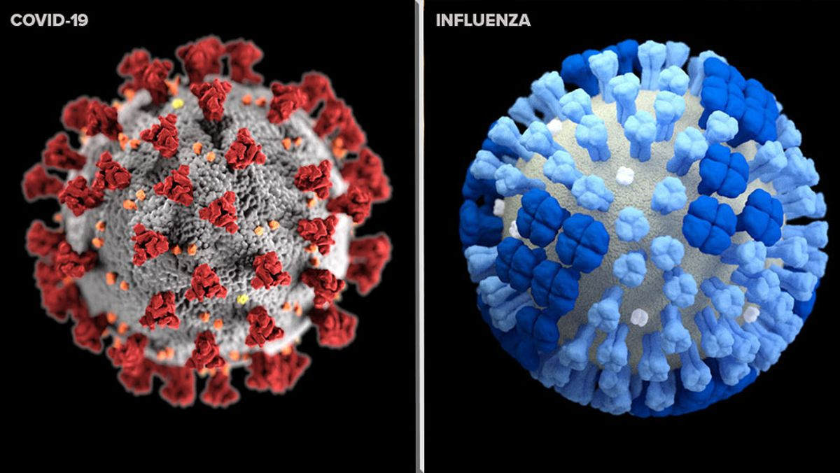
Co-Infection
5 of the 115 (4.3%) patients confirmed with COVID-19 were also diagnosed with influenza virus infection in a Chinese study. [13]
Patients with both COVID-19 and influenza virus infection did not appear to show a more severe condition. [13]
Stanford Data: [25]
  22% of the 49 confirmed COVID-19 cases.
  8.7% of the 127 people with other respiratory viruses — were found to be co-infected with COVID-19.
The findings challenge the assumption that people are unlikely to have COVID-19 if they have another type of viral respiratory disease.[25]
25.http://med.stanford.edu/news/all-news/2020/03/covid-19-can-coexist-with-other-respiratory-viruses.html
13. The clinical characteristics of pneumonia patients coinfected with 2019 novel coronavirus and influenza virus in Wuhan, China. J Med Virol. 2020 Mar 20. doi: 10.1002/jmv.25781

Slide 9
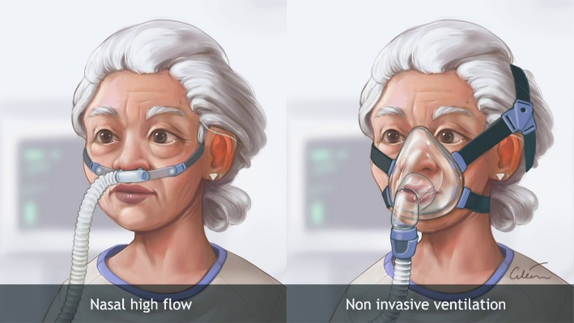
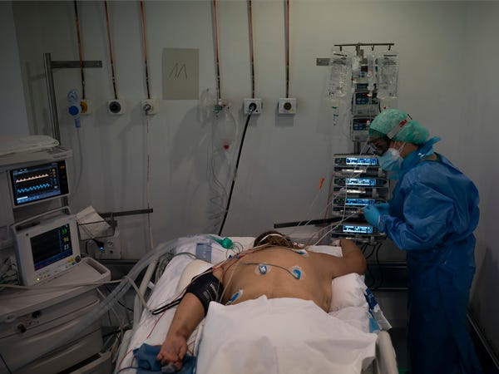
Supportive Care For COVID 19
Oxygen to keep O2>90% (but not higher than 96%).
Be aware: O2 NC > 5L increase risk of aerosolization.
Nebulizer vs MDI: Nebulizers are associated with aerosolization and potentially increase the risk of SARS-CoV-2 transmission.
Prefer High Flow over ventimask/Noninvasive Ventilation (BiPAP/CPAP)
Conservative fluid administration strategy
Mechanical ventilation: low tidal volume ventilation(4-8 mL/kg of predicted body weight)
Prone ventilation for 12 to 16 hours is suggested
Severe ARDS and hypoxemia despite optimizing ventilation, a trial of inhaled pulmonary vasodilator is suggested.
In COVID-19 patients receiving mechanical ventilation who have respiratory failure, use of empiric antimicrobial/antibacterial agents is suggested
Management of Critically Ill Adults With COVID-19. Poston JT, Patel BK, Davis AM. JAMA. 2020 Mar 26 [26]

Slide 10
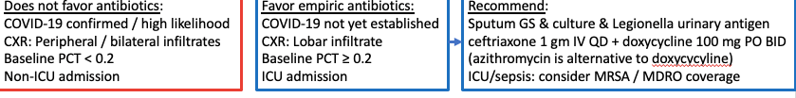
Antibiotics
MGH Approach
Routine empiric antibiotics are not recommended. Thus far, MGH has detected low rates of bacterial superinfection in COVID-19 patients.
For nonpregnant patients, doxycycline is preferred over azithromycin, in order to enhance coverage of Staphylococcus aureus and to reduce additive QTc risk with HCQ.
If started, usual course is 5 days. May discontinue if concern for bacterial pneumonia low (confirmation of COVID-19, classic presentation, PCT<0.2)
Note that from studies to date, procalcitonin remains low in the first 7-10 days of COVID-19 infection and can rise later on, even without bacterial superinfection. Repeating PCT is less specific late in the course of COVID-19 and generally unnecessary.
https://www.massgeneral.org/assets/MGH/pdf/news/coronavirus/mass-general-COVID-19-treatment-guidance.pdf

Slide 11
Antibiotics For COVID Patients
Our Approach
Use antibiotics if Procalcitonin> 0.20, high probability of having bacteria pneumonia or any ICU admissions.
Doxycycline + Ceftriaxone
May consider MRSA/MDRO coverage

Slide 12
NSAIDS and COVID 19
Non Covid 19 studies: Prolonged illness or the complications of respiratory infections may be more common when NSAIDs are used
Two randomized trials (not COVID 19 patients) that advice to use ibuprofen results in more severe illness or complications [8,9]
Ibuprofen’s anti-inflammatory properties could “dampen down” the immune system, which could slow the recovery process [7]
Based on similarities between the new virus (SARS-CoV-2) and SARS I, that covid-19 reduces a key enzyme that part regulates the water and salt concentration in the blood and could contribute to the pneumonia seen in extreme cases. “Ibuprofen aggravates this, while paracetamol does not,”[7]
Ibuprofen inhibits COX and Prostaglandin. Renal PGs predominantly have vasodilator effects on the kidneys which may reduce renal , increased sodium reabsorption that causes fluid retention and electrolyte imbalance such as hyperkalemia.
3/11/2020 Lancet: Iburpofen may increase ACE 2 receptors which could aggravate COVID 19 symptoms.
3/19/2020. FDA is not aware of scientific evidence connecting the use of NSAIDs, like ibuprofen, with worsening COVID-19 symptoms.

Slide 13
NSAIDS and COVID 19
Not sure if NSAIDS can worsen COVID-19 symptoms
Avoid taking ibuprofen for fever and cough for inpatient.
Use acetaminophen instead.

Slide 14
Steroid
SCCM: Yes for severe ARDS.
  In mechanical ventilated adults with COVID 19/severe ARDS, (eg, patients with a partial arterial pressure of oxygen/fraction of inspired oxygen [PaO₂:FiO₂] <100 mmHg). we suggest using systemic corticosteroids, over not using it. They should begin within the first 14 days, doses should be low, and courses should be short (eg, intravenous dexamethasone 20 mg IV once daily for five days, then 10 mg once daily for five days).
  https://link.springer.com/article/10.1007/s00134-020-06022-5
CDC: Avoid if possible. May use for COPD/septic shock
  patients with MERS-CoV or influenza who were given corticosteroids were more likely to have prolonged viral replication, receive mechanical ventilation, and have higher mortality. Therefore, corticosteroids should be avoided unless indicated for other reasons, such as management of chronic obstructive pulmonary disease exacerbation or septic shock.
  https://www.cdc.gov/coronavirus/2019-ncov/hcp/clinical-guidance-management-patients.html
International rheumatology society: Should not stop steroid but use minimal doses.
  Patients with rheumatic diseases on immunosuppressive therapy should not stop glucocorticoids during COVID-19 infection, although minimum possible doses may be used.

Slide 15
Steroidand COVID 19
Do not use it routinely for COVID 19.
May use it if patient has severe ARDS
May use it to treat COPD exacerbation
May use to treatment septic shock
May continue if patients have been taking it for rheumatic diseases (minimum possible dose)

Slide 16
Should We Avoid ACE-I/ARB
Angiotensin-converting enzyme 2 (ACE2) is a receptor for SARS-CoV-2 [1]
Renin-angiotensin-aldosterone system inhibitors have been shown to increase ACE2 levels in some, but not all, animal and human studies [2,3,5]
ACE2 is expressed by epithelial cells of the lung, intestine, kidney, and blood vessels. [5]
ACE2 expression is increased in diabetes and treatment with ACE inhibitors and ARBs increases ACE2 expression. Consequently, the increased expression of ACE2 would facilitate infection with COVID-19.
ACE2 can also be increased by thiazolidinediones and ibuprofen. [6]
On the other hand, it has been postulated that SARS-CoV-2 binding to ACE2 may attenuate residual ACE2 activity, skewing the ACE/ACE2 balance to a state of heightened angiotensin II activity leading to pulmonary vasoconstriction and inflammatory and oxidative organ damage, which increases the risk for acute lung injury (ALI). Conceivably, renin angiotensin system modulation, either by ACEIs/ARBs or recombinant ACE2, leading to increased expression of ACE2 may help mitigate some of these deleterious effects of angiotensin II. [10]
It is also postulated that increased levels of the soluble form of ACE2 may act as a competitive interceptor of SARS-CoV-2 and slow virus entry into the cells and protect from lung injury.[10]

Slide 17
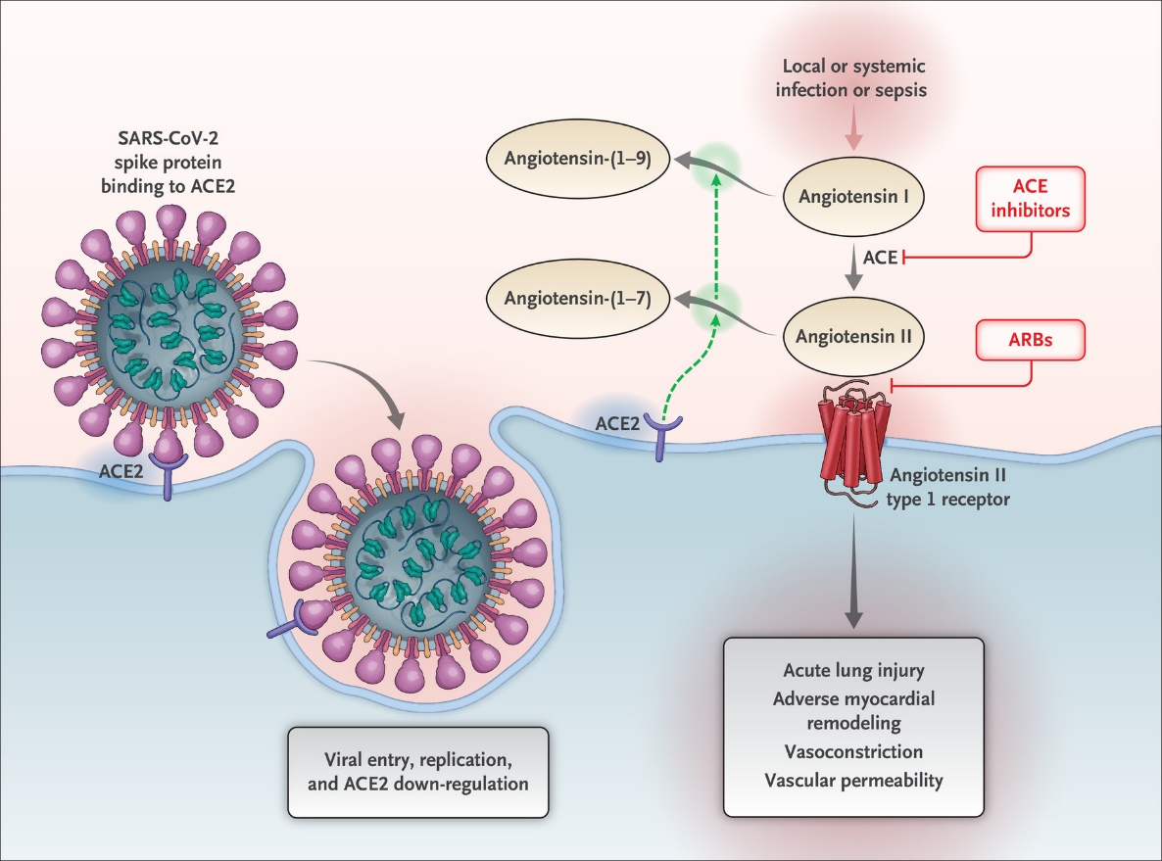
Renin- Angiotensin- Aldoterone System and COVID 19
Interaction between SARS-CoV-2 and the Renin–Angiotensin–Aldosterone System.
Shown is the initial entry of severe acute respiratory syndrome coronavirus 2 (SARS-CoV-2) into cells, primarily type II pneumocytes, after binding to its functional receptor, angiotensin-converting enzyme 2 (ACE2). After endocytosis of the viral complex, surface ACE2 is further down-regulated, resulting in unopposed angiotensin II accumulation. Local activation of the renin–angiotensin–aldosterone system may mediate lung injury responses to viral insults. ACE denotes angiotensin-converting enzyme, and ARB angiotensin-receptor blocker.
ACE2 is a key counterregulatory enzyme that degrades angiotensin II to angiotensin
ARBs may increase messenger RNA expression or protein levels of ACE2 in tissue
ACE inhibitors in clinical use do not directly affect ACE2 activity
N Engl J Med. 2020 Mar 30. doi: 10.1056/NEJMsr2005760. Renin-Angiotensin-Aldosterone System Inhibitors in Patients with Covid-19.

Slide 18
ACE-I/ARB and COVID 19
4/7/2020. ACC recommendations: COVID-19 Infection and Renin Angiotensin System Blockers [10]
Continuing ACEIs/ARBs in patients with COVID-19 unless clinically indicated.
Do not suggest initiation of ACEIs/ARBs in those without another clinical indication (e.g., hypertension, heart failure, diabetes), given the lack of strong evidence showing benefit of these medications in COVID-19.
A multicenter, double-blind, placebo-controlled phase 2 randomized clinical trial of starting losartan in patients with COVID-19 in outpatient settings (ClinicalTrials.gov identifier: NCT04311177) and in inpatient settings (ClinicalTrials.gov identifier: NCT04312009) is currently being planned and will provide additional insight.
https://www.acc.org/latest-in-cardiology/ten-points-to-remember/2020/04/07/12/25/coronavirus-disease-2019-infection-and-ras

Slide 19
ACE-I/ARB and COVID 19
Continue ACE-/ARB if patients have been on them and if they have indications for them.
Discontinue them if patient develop ARF or hypotension
Do not routinely start ACE-I or ARB for COVID 19 treatment. But may start (losartan) if patients have indications for it.

Slide 20
Statin and COVID 19
Case fatality rates for comorbid patients are materially higher than the average population:
  Cancer: 5.6%
  Hypertension: 6.0%
  Chronic respiratory disease: 6.3%
  Diabetes: 7.3%
  Cardiovascular disease: 10.5%
A high proportion of patients with severe COVID-19 have underlying cardiovascular disease, diabetes mellitus, and other indications for use of statins.
Acute cardiac injury is a reported complication of COVID-19.
Concerned about hepatotoxicity from statins, since transaminase elevations are common in COVID-19, most evidence indicates that liver injury from statins is uncommon
Inhibitors of the MYD88 pathway, which results in marked inflammation
One randomized controlled trial (RCT, open-label) showed possible beneficial effects of oral administration of statin in reducing mortality in those with ventilator associated pneumonia.^{[11]} In contrast, the results of another RCT do not support statin administration in those with ventilator-associated pneumonia [12]

Slide 21
Statin
statin therapy should be continued in patients with suspected COVID-19 infection as acute cardiac injury has been described in these patients.
Clinicians should also pay close attention to ensure that their high-risk primary prevention patients are also on guideline-directed statin therapy in the outpatient setting. This will help mitigate some of the increased risk of cardiovascular events associated with COVID-19 infection.
In patients with active COVID-19 infection who may develop severe rhabdomyolysis (frequency unknown at this time), it may be prudent to withhold statin therapy for a short period of time.

Slide 22
Statin and COVID 19
Continue statin unless there is contraindications such as abnormal LFT or rhabdomyolysis.
May start it if patients have indications for it and no evidence of abnormal LFT or significant rhabdomyolysis (if CK < 500).

Slide 23

COVID 19 Vaccine vs Treatments
Vaccine typically takes years.
Under urgency of this pandemic, it will take at least a year to know if any vaccine is safe and effective.
It won’t be widely available until at least the fall
So trying a wide range of existing drugs is the only near term hope.

Slide 24
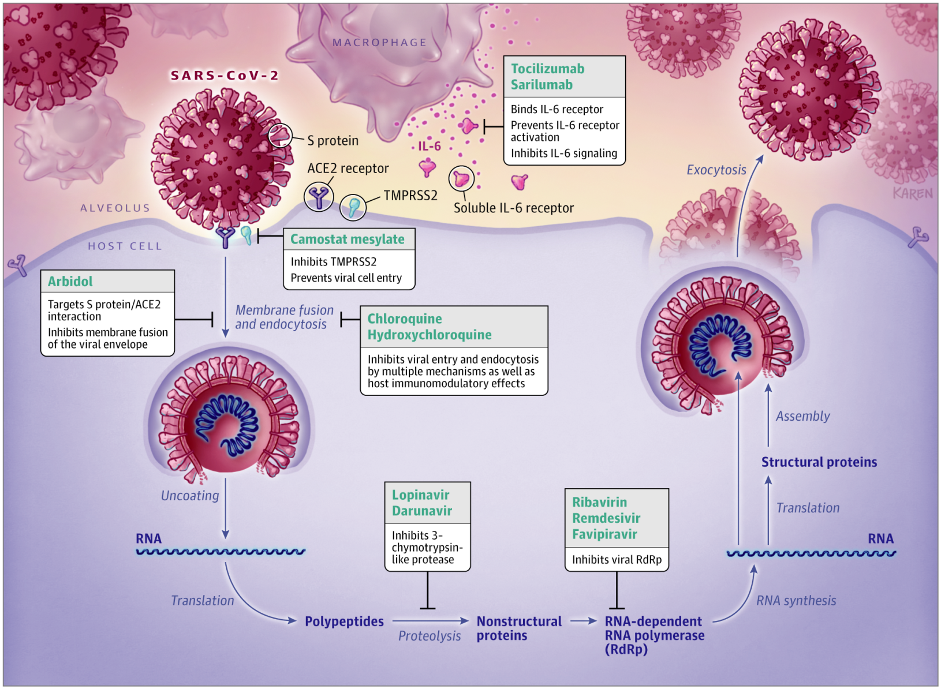
Pharmacologic Treatment For COVID 19
JAMA. 2020 Apr 13. doi: 10.1001/jama.2020.6019. Pharmacologic Treatments for Coronavirus Disease 2019 (COVID-19): A Review [21]

Slide 25

Severe COVID 19 and Cytokine Storm

Slide 26
Virology of SARS COV 2
SARS COV 2 targets cells through the viral structural spine (S) protein that bind to the angiotensin-converting enzyme 2 (ACE2) receptor.
Viral particle uses host cell receptors and endosomes to enter cells.
A host type 2 transmembrane serine protease, TMPRESS2, facilitates cell entry via the S protein.
Once inside the cells, viral polyproteins are synthesized that encode for the replicase-transcriptase complex.
Synthesizes RNA via RNA dependent RNA polymerase.
Structural proteins are synthesized leading to completion of assembly and release of viral particles.

Slide 27
Clinical Course in the ICU

Slide 28

Cytokine Storm

Slide 29
Potential Treatments
Remdesivir
Hydroxychloroquine/Chloroquine
Azithromycin
IL 6 inhibitors: Kevzara, Actemra (Tocilizumab)
Convalescent plasma
Jakafi: JAK inhibitor
Avigan (influenza and a broad spectrum antiviral drug)
Kaletra (HIV therapy)
Galidesivir (experimental antiviral treatement to fight againse RNA viruses)
Remestermcel-L (stem cell therapy)
Tradipitant (inhibit neurokinin-1/NK-1)
Selinexor (block viral protein to prevent virus spread)
Kineret (IL-1 inhibitor)
Losartan
https://www.businessinsider.com/list-coronavirus-treatments-tested-in-clinical-trials-2020-4?utm_source=msn.com&utm_medium=referral&utm_content=msn-story&utm_campaign=bodyurl

Slide 30
Hydroxychloroquine and Chloroquine
An anti malaria drug, also used for SLE and RA.
Hydroxychloroquin was reported to have anti-SARS-Cov activity in Vitro
Hydroxychloroquin is better than Chloroquin in Vitro [14]
Change the PH at the surface of the cell membrane, inhibit the fusion of the virus.
Inhibit nucleic acid replication, glycosylation of viral proteins, virus assembly, new virus transport, virus release and other processes.

Slide 31
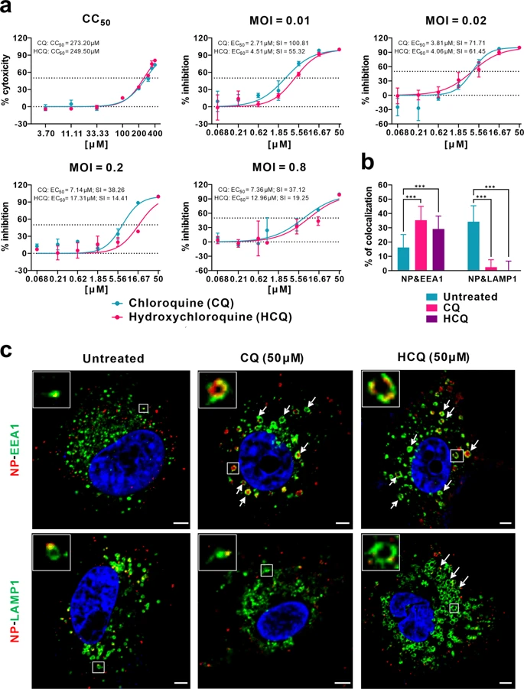
Antiviral properties
Makes the intracellular milieu less acidic, lysosomal pH stabilizes lysosomal membranes
Inhibits antigen antibody reactions
Suppresses lymphocyte responses to mitogens
Inhibits phospholipase activity
Inhibits chemotaxis
Nitric oxide production
Interfere with IL11 release by monocytes
Interfere with TNF alpha, IL6 and IFN-y
Inhibits natural killer activity
Induce apoptosis
Toll-like receptor 7/9 antagonist
inhibits cell entry
inhibit the synthesis of DNA, RNA, and protein
Decreases ACE 2 expression
Norman T. Ilowite, Ronald M. Laxer, in Textbook of Pediatric Rheumatology (Sixth Edition), 2011

Slide 32
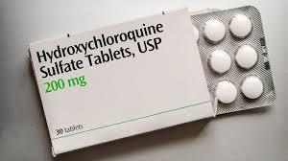
Hydroxychloroquine
half-life of around 50 days
interfere with lysosomal activity and autophagy
interact with membrane stability and
alter signaling pathways and transcriptional activity,
which can result in inhibition of cytokine production and modulation of certain co-stimulatory molecules.

Slide 33
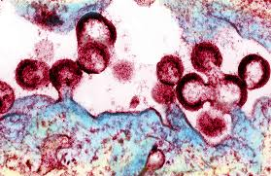
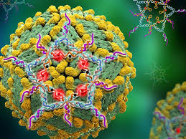
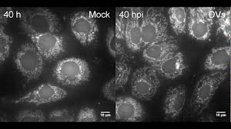
Other viruses and (hydroxy)chloroquine
In vitro activity against HIV but in an RCT in patients that were not taking antivirals it lowered CD4 counts
In vitro activity against Dengue fever but failed in RCT to show benefit

Slide 34
Con:
No clinical evidence or only weak evidence
In vitro evidence that it works for Covid 19
it may not show benefit in clinical practice based on past experience with other viruses.
No evidence in other viral illnesses to suggest clinical benefit, ( it has not been examined for SARS 1).
Though it has in vitro an effect of viral replication it is likely not to be beneficial in the body. The in vitro effect is achieved at a micromolar concentration, and this concentration is ? achieved in the body/tissues where the virus replicates. (Most antiviral drugs work at the nanomolar concentration in (human) tissues.)
Adult ID and SCCM guidelines are somewhat neutral to its use due to lack of (high quality) evidence and suggest use only in an RCT
Has side effects like prolonging QT interval
Makes the drug less available to Lupus patients
Does Not have FDA indication as antiviral (COVID)

Slide 35
Pro:
It’s benefit may be due to its effect as an immunosuppressant (Lupus literature) with the proposed rationale that it modulates the host response to Covid,
there is some evidence to this end for Chloroquin or its metabolite hydroxychloroquine but only limited clinical benefit.
At this time, it is likely that it has a marginal effect based on it’s anti inflammatory effects which in lupus only become evident after weeks of administration.
It diminishes viral production in vitro, but no animal or human data, but does it have to be given early? (probably way prior to ICU admission)
A recent preliminary French study suggest benefit in Covid, but the early results published by Gautret are not of high quality and small in size, and there are signs of design flaws. Other Studies published from Wuhan and last week from France do not show benefit.
Only case studies in children, small and more anecdotal in nature to use it for clinical decision making.

Slide 36
Hydroxychloroquine For Mild COVID Pneumonia
A Chinese Randomized Trial
Total 62 patients. 31 patients in the treatment group
No ARDS or ALI patients. PaO2/FiO2 > 300.
A randomized trial of patients with mild COVID-19 pneumonia without hypoxia reported that adding hydroxychloroquine to standard of care resulted in a slightly faster time to improvement in fever, cough, and chest imaging findings and possibly a lower likelihood of progression to severe disease;
However, the trial has not been published in a peer-reviewed journal, and there are concerns about concomitant co-therapies, baseline differences between the groups, and lack of blinding or placebo control
Patients had STANDARD treatments including other antiviral, antibacterial and Immunoglobulin, steroids, which can be a confounding factor.
None of the 80 SLE patients who took long term oral hydroxychloroquin had been confirmed to have SARS COV2 infection or appeared to have related symptoms.
                https://www.medrxiv.org/content/10.1101/2020.03.22.20040758v2

Slide 37
Review of French Study
hospital admission for isolation in some cases,
no stratification of when the patient was infected.
Only 2 patients were asymptomatic in the treatment group:
  ? Further along in the disease course.
  nasopharyngeal carriage becomes negative about 7-10 days after infection in most patients. Actually for those that go on to become sicker than a cold it can be found in the lungs for much longer and it is a different strain. So, it is not clear that what is perceived as virological clearance may be the natural course and due to sample size and errors the treatment effect was over estimated.
Exclusion of patients that went to the ICU and were lost to follow up. (16 patients)
Age groups averages were different : Control group = 37y treatment group 51 y
4. No clinical correlate was given that would correlate with the benefit of earlier clearance.
5. Asymptomatic patients had less effect, ?why.

Slide 38
Hydroxychloroquine + Azithromcycin
The French Study
Open-label non-randomized clinical, 36 patients. [4]
BACKGROUND Chloroquine and hydroxychloroquine have been found to be efficient on SARS-CoV-2, and reported to be efficient in Chinese COV-19 patients. We evaluate the role of hydroxychloroquine on respiratory viral loads.
Single arm protocol from early March to March 16th
receive 600mg of hydroxychloroquine (200mg tid) daily
viral load in nasopharyngeal swabs was tested daily in a hospital setting.
Depending on their clinical presentation, azithromycin was added to the treatment in 6 patients.
Untreated patients from another center and cases refusing the protocol were included as negative controls.
Presence and absence of virus at Day6-post inclusion was considered the end point.
RESULTS Six patients were asymptomatic, 22 had upper respiratory tract infection symptoms and eight had lower respiratory tract infection symptoms. 20 cases were treated in this study and showed a significant reduction of the viral carriage at D6-post inclusion compared to controls (14/20, 70% vs 2/16, 12.5%), and much lower average carrying duration than reported of untreated patients in the literature. Azithromycin added to hydroxychloroquine was significantly more efficient for virus elimination (6/6, 100%).
6 patients were removed in the treatment group due to critical disease and intolerance
CONCLUSION Despite its small sample size our survey shows that hydroxychloroquine treatment is significantly associated with viral load reduction/disappearance in COVID-19 patients and its effect is reinforced by azithromycin.

Slide 39
Hydroxychloroquine: Harmful?
NEJM Rapid Review submitted 4/4/2020 (Wayne State and Henry Ford Hospital)
Clinical Outcomes of Hydroxychloroquine in hospitalized patients with COVID 19: A Quasi Randomized Comparative Study
Compare Hydroxychloroquine and supportive care
Primary endpoint: effect of usage of Hydroxychloroquine on the need to escalate respiratory support, change in lymphocyte count and neutrophil to lymphocyte ratio
63 patients. 32 in Hydroxychloroquine arm.
Hydroxychloroquine was associated with a need for escalation of respiratory support level at 5 days, even in a baseline matched subgroup analysis.
No difference in lymphocyte change
Trend toward worsening neutrophil to lymphocyte ratio
Trend toward higher risk of intubation
Conclusion: Hydroxychloroquine administration to the hospitalized SARS COV 2 positive population was associated with an increased need for escalation of respiratory support. No benefit on mortality, lymphopenia, or neutrophil to lymphocyte ratio improvement.

Slide 40
Outcomes of hydroxychloroquine usage in United States veterans hospitalized with Covid-19
4/22/2020
BACKGROUND: Despite limited and conflicting data on the use of hydroxychloroquine in patients with Covid-19, the U.S. Food and Drug Administration has authorized the emergency use of this drug when clinical trials are unavailable or infeasible. Hydroxychloroquine, alone or in combination with azithromycin, is being widely used in Covid-19 therapy based on anecdotal and limited observational evidence.
METHODS: We performed a retrospective analysis of data from patients hospitalized with confirmed SARS-CoV-2 infection in all United States Veterans Health Administration medical centers until April 11, 2020. Patients were categorized based on their exposure to hydroxychloroquine alone (HC) or with azithromycin (HC+AZ) as treatments in addition to standard supportive management for Covid-19. The two primary outcomes were death and the need for mechanical ventilation. We determined the association between treatment and the primary outcomes using competing risk hazard regression adjusting for clinical characteristics via propensity scores. Discharge and death were taken into account as competing risks and subdistribution hazard ratios are presented.
RESULTS: A total of 368 patients were evaluated (HC, n=97; HC+AZ, n=113; no HC, n=158). Rates of death in the HC, HC+AZ, and no HC groups were 27.8%, 22.1%, 11.4%, respectively. Rates of ventilation in the HC, HC+AZ, and no HC groups were 13.3%, 6.9%, 14.1%, respectively. Compared to the no HC group, the risk of death from any cause was higher in the HC group (adjusted hazard ratio, 2.61; 95% CI, 1.10 to 6.17; P=0.03) but not in the HC+AZ group (adjusted hazard ratio, 1.14; 95% CI, 0.56 to 2.32; P=0.72). The risk of ventilation was similar in the HC group (adjusted hazard ratio, 1.43; 95% CI, 0.53 to 3.79; P=0.48) and in the HC+AZ group (adjusted hazard ratio, 0.43; 95% CI, 0.16 to 1.12; P=0.09), compared to the no HC group.
CONCLUSIONS: In this study, we found NO EVIDENCE that use of hydroxychloroquine, either with or without azithromycin, reduced the risk of mechanical ventilation in patients hospitalized with Covid-19. An association of increased overall mortality was identified in patients treated with hydroxychloroquine alone. These findings highlight the importance of awaiting the results of ongoing prospective, randomized, controlled studies before widespread adoption of these drugs.
doi: https://doi.org/10.1101/2020.04.16.20065920
https://www.medrxiv.org/content/10.1101/2020.04.16.20065920v1

Slide 41
Side Effect of Hydroxychloroquine
Serious adverse effects are rare (10%)
QTc prolongation: Need to have baseline EKG and then daily.
Liver toxicity (Need daily LFT)
Hypoglycemia
Neuropsychiatric effect
Retinopathy

Slide 42
New NIH Recommendation For COVID 19
April 21, 20204:15 PM ET
Recommend against using a combination of hydroxychloroquine and azithromycin because of potential toxicities.
As for using the use of hydroxychloroquine or chloroquine alone, the panel said there was "insufficient clinical data to recommend either for or against." It reached the same conclusion about the drug remdesivir.
Recommended against using Lopinavir/ritonavir or other HIV protease inhibitors because of negative clinical trial data.
Recommended against using interferon because it seemed to make patients with SARS and MERS worse.

Slide 43
2019 Novel Coronavirus COVID-19 ISDH Webinar
April 17, 2020
Lindsay Weaver MD FACEP
  Chief Medical Officer
  Indiana State Department of Health
Hydroxychloroquine: At this point, the data has alternated between mediocre and totally negative, with a skew towards just totally negative.

Slide 44
Hydroxychloroquine and COVID 19
Our Experience
Yes we have been using it
Not very effective for severe disease based on our experience.
Not sure if we should use it now. May consider to start it earlier for patients having mild to moderate disease who is admitted to the hospital.
Not using it for primary prevention yet (waiting for clinical trials).
Do Not use it together with azithromycin (use doxycycline instead)
High risk for side effects: QT prolongation (2 patients), SVT (1 patient), Diplopia (1 patients) and Liver toxicity (1 patients). 5/6 those patients were intubated or on high flow.
We have treated 14 patients with HCQ +/- Azithromycin.

Slide 45
Hydroxychloroquine
Hydroxychloroquine 400mg po bid x 2 doses then 200mg po bid for 4 days.
CBC, BMP, LFT daily
EKG daily, hold if QTc > 500

Slide 46
Convalescent Plasma
Case series Study. [22]
5 critically ill patients with laboratory-confirmed COVID-19 and acute respiratory distress syndrome (ARDS)
Severe pneumonia with rapid progression and continuously high viral load despite antiviral treatment
Pao2/Fio2<300; and mechanical ventilation.
All 5 were treated with convalescent plasma transfusion.
The donors had been well (asymptomatic) for at least 10 days, with a serum SARS-CoV-2–specific ELISA antibody titer higher than 1:1000 and a neutralizing antibody titer greater than 1:40. Following donation, 400 mL of convalescent plasma was obtained from each donor by apheresis, and the plasma was immediately transfused to the recipients on the same day it was obtained.
All 5 patients were receiving mechanical ventilation at the time of transfusion, and 3 patients (patients 3, 4, and 5) were weaned from mechanical ventilation Patient 2 was receiving ECMO at the time of plasma treatment but did not require ECMO on day 5 after transfusion. Patients 3, 4, and 5 were discharged from the hospital (length of stay: 53, 51, and 55 days, respectively). As of March 25, 2020, patients 1 and 2 remained hospitalized, with lengths of stay of 37 days each.
3 have been discharged from the hospital (length of stay: 53, 51, and 55 days), and 2 are in stable condition at 37 days after transfusion
JAMA. 2020 Mar 27. doi: 10.1001/jama.2020.4783. Treatment of 5 Critically Ill Patients With COVID-19 With Convalescent Plasma

Slide 47
FDA Criteria For Convalescent Plasma
Laboratory confirmed COVID-19
Severe or immediately life-threatening COVID-19, for example,
  Severe disease is defined as one or more of the following:
    shortness of breath (dyspnea),
    respiratory frequency ≥ 30/min,
    blood oxygen saturation ≤ 93%,
    partial pressure of arterial oxygen to fraction of inspired oxygen ratio < 300,
    lung infiltrates > 50% within 24 to 48 hours
  Life-threatening disease is defined as one or more of the following:
    respiratory failure,
    septic shock,
    multiple organ dysfunction or failure
Informed consent provided by the patient or healthcare proxy.

Slide 48
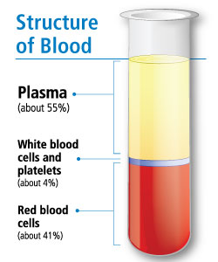
FDA Convalescent Plasma Donor Eligibility
Evidence of COVID-19 documented by a laboratory test either by:
  A diagnostic test (e.g., nasopharyngeal swab) at the time of illness
  OR
  a positive serological test for SARS-CoV-2 antibodies after recovery, if prior diagnostic testing was not performed at the time COVID-19 was suspected.
Either one of the following
1. Complete resolution of symptoms at least 28 days prior to donation
OR
2. Complete resolution of symptoms at least 14 days prior to donation, AND Negative results for COVID-19 either from one or more nasopharyngeal swab specimens or by a molecular diagnostic test from blood.
Male donors, or female donors who have not been pregnant, or female donors who have been tested since their most recent pregnancy and results interpreted as negative for HLA antibodies.
SARS-CoV-2 neutralizing antibody titers, if available
  When measurement of neutralizing antibody titers is available, we recommend neutralizing antibody titers of at least 1:160. A titer of 1:80 may be considered acceptable if an alternative matched unit is not available.
  When measurement of neutralizing antibody titers is not available, consider storing a retention sample from the convalescent plasma donation for determining antibody titers at a later date.

Slide 49
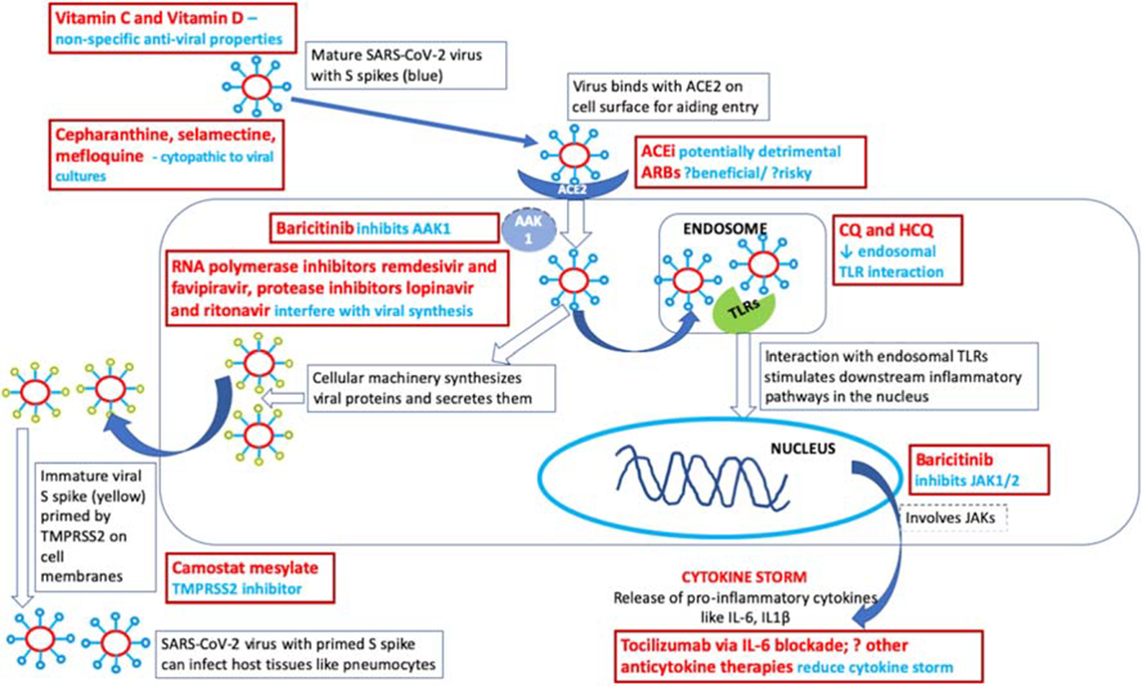
Tocilizumab
Potential therapeutic targets for SARS-CoV-2 and COVID-19. AAK1–AP2-associated protein kinase 1; ACE–angiotensin-converting enzyme; ARB–angiotensin receptor blocker; COVID-19–coronavirus disease 19; CQ–chloroquine; HCQ–hydroxychloroquine; IL–interleukin; JAK–Janus kinase; SARS-CoV-2–severe acute respiratory syndrome coronavirus 2; TLR–toll-like receptor; TMPRSS2–serine protease enzyme
Clin Rheumatol. 2020 Apr 10. doi: 10.1007/s10067-020-05073-9. Rheumatologists' perspective on coronavirus disease 19 (COVID-19) and potential therapeutic targets

Slide 50
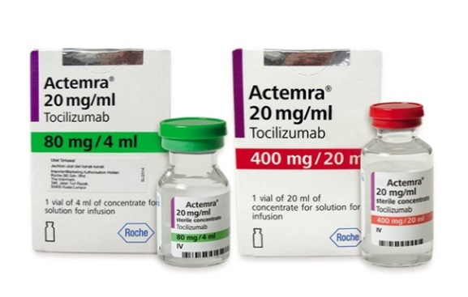
Tocilizumab
monoclonal antibody against interleukin‐6 (IL‐6)
Tocilizumab treatment in COVID‐19: a single center experience [20]
Totally 15 patients with COVID‐19 were included in this study.
2 of them were moderately ill, 6 were seriously ill and 7 were critically ill.
Elevated IL‐6 is the indication for TCZ use in COVID‐19. The levels of IL‐6 before TCZ administration ranged from 16.4 to 627.1 pg/mL
The TCZ was used in combination with methylprednisolone (MP) in 8 patients.
5 patients received the TCZ administration twice or more.
Repeated doses (even repeated with a lower dose) of TCZ might improve the condition of critically ill patients.
Although TCZ treatment ameliorated the increased CRP in all patients rapidly, for the 4 critically ill patients who received only single dose of TCZ, 3 of them (No. 1, 2, and 3) still dead and the CRP level in the rest 1 patient (No. 7) failed to return to normal range with a clinical outcome of disease aggravation.
Serum IL‐6 level tended to further spiked firstly and then decreased after TCZ therapy in 10 patients.
A persistent and dramatic increase of IL‐6 was observed in these 4 patients who failed treatment.

Slide 51
Tocilizumab
Does not seem to be very promising
Need to have elevated IL 6
May consider to use in patient with moderate to severe disease. May not work well on critically ill patients.
If IL 6 does not drop, this may indicating failure of the medication.

Slide 52
Tocilizumab
NIH Recommendation
4-8mg/kg IV x 1.
Then give the same dose >/=12 hr if fever persists.
Usual dose 400mg, maximal 800mg

Slide 53
IVIG
No data
May consider if IgG < 400

Slide 54
Lopinavir/Ritonavir (Kaletra)
We Do Not Use It
A Trial of Lopinavir–Ritonavir in Adults Hospitalized with Severe Covid-19 [18]
A randomized, controlled, open-label trial
NEJM 3/18/2020.
lopinavir–ritonavir treatment did not significantly accelerate clinical improvement, reduce mortality, or diminish throat viral RNA detectability in patients with serious Covid-19.
A Trial of Lopinavir–Ritonavir in Adults Hospitalized with Severe Covid-19, NEJM, March 18, 2020

Slide 55
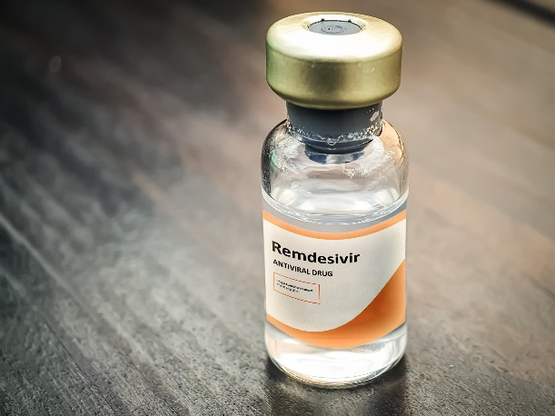
Remdesivir
Remdesivir (Gilead Science) is a prodrug of a nucleotide (adenosine) analogue that is intracellularly metabolized to an analogue of adenosine triphosphate that inhibits viral RNA polymerases
It incorporates into nascent viral RNA chains and results in pre-mature termination
It is a IV medication
Gilead Sciences began accepting requests from clinicians for compassionate use of remdesivir on January 25, 2020

Slide 56
Remdesivir
3/5 NEJM reported the first case who was treated with Remdesivir. [16]
  1/19 a 35 y/o man from China was seen in University of Washington ER. He was DC home with isolation and active monitoring.
  1/20 he was found to be positive and he was admitted.
  O2 2L on hospital day 5 and CXR showed LLL infiltrate. Vanco and cefepime started.
  CXR on hospital day 6 (illness day 9) started to showed atypical pneumonia.
  Hospital day 7 started Remdesivir and Vanco/cefepime DC’ed.
  Day 8 physical exam showed no rales. No longer required O2. Clinical symptoms improved.
N Engl J Med. 2020 Mar 5;382(10):929-936

Slide 57
Remdesivir
Now we have data (collected before 3/30/2020). [15]
An open-label study
10-day course of remdesivir
200 mg IV on day 1
Followed by 100 mg daily x 9 days
Compassionate Use of Remdesivir for Patients with Severe Covid-19. N Engl J Med. 2020 Apr 10. doi: 10.1056

Slide 58
Remdesivir
53 patients in the compassionate-use cohort. Patients were enrolled in the United States (22 patients), Japan (9), Italy (12), Austria (1), France (4), Germany (2), Netherlands (1), Spain (1), and Canada (1).
A total of 40 patients (75%) were men, the age range was 23 to 82 years, and the median age was 64 years (interquartile range, 48 to 71).
At baseline, the majority of patients (34 [64%]) were receiving invasive ventilation, including 30 (57%) receiving mechanical ventilation and 4 (8%) receiving ECMO.
The median duration of invasive mechanical ventilation before the initiation of remdesivir treatment was 2 days (interquartile range, 1 to 8).

Slide 59
Remdesivir
Over a median follow-up of 18 days
36 of 53 patients (68%) showed an improvement in the category of oxygen support, whereas 8 of 53 patients (15%) showed worsening
17 of 30 patients (57%) who were receiving invasive mechanical ventilation were extubated, and 3 of 4 patients (75%) receiving ECMO stopped receiving it
Improvement was observed in all 12 patients who were breathing ambient air or receiving low-flow supplemental oxygen and in 5 of 7 patients (71%) who were receiving noninvasive oxygen support (NIPPV or high-flow supplemental oxygen).
25 of 53 patients (47%) had been discharged (24% receiving invasive ventilation [8 of 34 patients] and 89% [17 of 19 patients] receiving noninvasive oxygen support).
all were alive at last follow-up 18 days
By 28 days of follow-up, the cumulative incidence of clinical improvement is 84%
improvement was less frequent among patients receiving invasive ventilation than among those receiving noninvasive ventilation (This is understandable)
Mortality: Seven of the 53 patients (13%) died after the completion of remdesivir treatment, including 6 of 34 patients (18%) who were receiving invasive ventilation and 1 of 19 (5%) who were receiving noninvasive oxygen support

Slide 60
Remdesivir
Among 201 patients hospitalized in Wuhan, China, mortality was 22% overall and 66% (44 of 67) among patients receiving invasive mechanical ventilation. [17]
Remdesivir 18% among patients receiving vents and 5% on NIV O2, overall 13% treated patients.
Italian COVID 19 mortality data. Date collected on 4/12/2020, 19,468/152,271 (12.8%).

Slide 61
Remdesivir: Compassionate Use
Approval of requests was reserved for hospitalized patients who had SARS-CoV-2 infection confirmed by reverse-transcriptase–polymerase-chain-reaction assay
Either an oxygen saturation of 94% or less while the patient was breathing ambient air or a need for oxygen support.
CrCl>30 ml/min
Serum levels of alanine aminotransferase (ALT) and aspartate aminotransferase (AST) <5x the upper limit of the normal range
Patients have to agree not to use other investigational agents for Covid-19.

Slide 62
Safety
Total of 32 patients (60%) reported adverse events during follow-up
The most common adverse events were increased hepatic enzymes, diarrhea, rash, renal impairment, and hypotension.
In general, adverse events were more common in patients receiving invasive ventilation.
A total of 12 patients (23%) had serious adverse events.
The most common serious adverse events — multiple-organ-dysfunction syndrome, septic shock, acute kidney injury, and hypotension — were reported in patients who were receiving invasive ventilation at baseline.
Four patients (8%) discontinued remdesivir treatment prematurely: one because of worsening of preexisting renal failure, one because of multiple organ failure, and two because of elevated aminotransferases, including one patient with a maculopapular rash.

Slide 63
References
  Proc Natl Acad Sci U S A. 2020;
  Proc Natl Acad Sci U S A. 2020;
  Proc Natl Acad Sci U S A. 2020;
  Proc Natl Acad Sci U S A. 2020;
[1] J Virol. 2020;94(7) Epub 2020 Mar 17.
2. JAMA. 2020 Mar 24. COVID-19 and Angiotensin-Converting Enzyme Inhibitors and Angiotensin Receptor Blockers: What Is the Evidence?
3. N Engl J Med. 2020 Mar 30. Renin-Angiotensin-Aldosterone System Inhibitors in Patients with Covid-19.
4. Hydroxychloroquine and azithromycin as a treatment of COVID-19: results of an open-label non-randomized clinical trial. Int J Antimicrob Agents. 2020 Mar 20:105949. doi: 10.1016/j.ijantimicag.2020.105949
5. Receptor recognition by novel coronavirus from Wuhan: An analysis based on decade long structural studies of SARS. J Virology 2020; published online Jan 29. DOI:10.1128/JVI.00127-20.
6. Are patients with hypertension and diabetes mellitus at increased risk for COVID-19 infection? March 11, 2020 letter in The Lancet medical journal.https://doi.org/10.1016/S2213-2600(20)30116-8
7. Covid-19: ibuprofen should not be used for managing symptoms, say doctors and scientists BMJ 2020; 368 doi: https://doi.org/10.1136/bmj.m1086
8. Little P, Moore M, Kelly J, Williamson I, Leydon G, McDermott L, et al. Ibuprofen, paracetamol, and steam for patients with respiratory tract infections in primary care: pragmatic randomised factorial trial. BMJ. 2013;347:https://www.bmj.com/content/347/bmj.f6041.
9. Little P, Stuart B, Andreou P, McDermott L, Joseph J, Mullee M, et al. Primary care randomised controlled trial of a tailored interactive website for the self-management of respiratory infections (Internet Doctor). BMJ open. 2016;6(4):e009769.
10. https://www.acc.org/latest-in-cardiology/ten-points-to-remember/2020/04/07/12/25/coronavirus-disease-2019-infection-and-ras
11. D. Makris, E. Manoulakas, A. Komnos et al. Effect of pravastatin on the frequency of ventilator-associated pneumonia and on intensive care unit mortality: open-label, randomized study. Critical Care Medicine, vol. 39, no. 11, pp. 2440–2446.
12. L. Papazian, A. Roch, P.-E. Charles et al. Effect of statin therapy on mortality in patients with ventilator-associated pneumonia: a randomized clinical trial. Journal of the American Medical Association, vol. 310, no. 16, pp. 1692–1700.
13. The clinical characteristics of pneumonia patients coinfected with 2019 novel coronavirus and influenza virus in Wuhan, China. J Med Virol. 2020 Mar 20. doi: 10.1002/jmv.25781
14. In Vitro Antiviral Activity and Projection of Optimized Dosing Design of Hydroxychloroquine for the Treatment of Severe Acute Respiratory Syndrome Coronavirus 2 (SARS-CoV-2). Clin Infect Dis. 2020;
15. N Engl J Med. 2020 Apr 10. doi: 10.1056/NEJMoa2007016. [Epub ahead of print]
Compassionate Use of Remdesivir for Patients with Severe Covid-19.
16. N Engl J Med. 2020 Mar 5;382(10):929-936. doi: 10.1056/NEJMoa2001191. Epub 2020 Jan 31.
First Case of 2019 Novel Coronavirus in the United States
17. Risk factors associated with acute respiratory distress syndrome and death in patients with coronavirus disease 2019 pneumonia in Wuhan, China. JAMA Intern Med 2020 March
18. A Trial of Lopinavir–Ritonavir in Adults Hospitalized with Severe Covid-19, NEJM, March 18, 2020
19. The Lancet, Volume 395, Issue 10229, 28 March–3 April 2020, Pages 1033-1034. COVID-19: consider cytokine storm syndromes and immunosuppression
20. J Med Virol. 2020 Apr 6. doi: 10.1002/jmv.25801. Tocilizumab treatment in COVID-19: a single center experience.
21. JAMA. 2020 Apr 13. doi: 10.1001/jama.2020.6019. Pharmacologic Treatments for Coronavirus Disease 2019 (COVID-19): A Review
22. JAMA. 2020 Mar 27. doi: 10.1001/jama.2020.4783. Treatment of 5 Critically Ill Patients With COVID-19 With Convalescent Plasma
23. Proc Natl Acad Sci U S A. 2020; Effectiveness of convalescent plasma therapy in severe COVID-19 patients.
24. Int J Rheum Dis. 2020 Apr 13. doi: 10.1111/1756-185X.13842. A systematic review of the prophylactic role of chloroquine and hydroxychloroquine in Coronavirus Disease-19 (COVID-19).
25. http://med.stanford.edu/news/all-news/2020/03/covid-19-can-coexist-with-other-respiratory-viruses.html
26. Management of Critically Ill Adults With COVID-19. Poston JT, Patel BK, Davis AM. JAMA. 2020 Mar 26

Slide 64

Questions

